Slide 1


Mellanox Call Center Data Analyzer
Presented by:
Benjamin-Alex Filin
Anan Fakheraldin
Supervised by:
Dr. Malka Grossman
Department of Software Engineering
24.1.2016

Slide 2
Concise
Our project is based on the industrial need of Mellanox Technologies:
1) To handle customer issues in a more efficient day-to-day and long term work environment.
2) Analyses customer’s fabric errors on time and to fix them.
3) Configurational scale errors to advice on threshold.
We employ methods of machine learning to build an efficient workflow to troubleshoot a problem in a customer’s network.

Slide 3
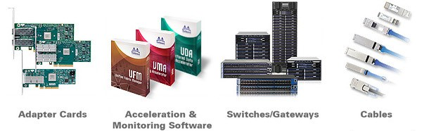
Mellanox overview
Mellanox Technologies is a leading supplier of end-to-end InfiniBand and Ethernet interconnect solutions and services for servers and storage.
Mellanox offers a choice of fast interconnect products: adapters, switches, software and silicon that accelerate application runtime and maximize business results for a wide range of markets including high performance computing.

Slide 4
Mellanox Call Center
Mellanox Call Center - provides permanent manned support services for Mellanox customers throughout the year (7/24/365) based on the appropriate support contract.
The Call Center is the customer’s point of contact (mostly for emergency cases) for initiating and advancing technical related and support administrative issues.
SalesForce - Mellanox's online Customer Resource Management (CRM) system, provides a comprehensive online tool to manage all of the customer's support issues in one place.

Slide 5
Mellanox Care – Proactive Care Platform
Mellanox Care services use a combination of advanced monitoring software with a 24/7 human expert service of Mellanox personnel:
1) Keep alive Events - that will alert and address hardware failures, non-optimal configuration and more. In order to keeping the fabric healthy.
2) Daily Report - a snapshot of the environment it is running on, at pre-defined time and send it to Support call center for review.

Slide 6
Motivation
Our goal is to develop a data analyzer that can substitute the support engineer’s work on Mellanox care, to resolve all fabric errors using artificial intelligence methods.
Resource limitations:
Data from Mellanox database is classified.
Processing time.

Slide 7
Main Workflow
Mellanox care - Keep Alive event
*
Score the engineer’s reply.
Suggest a solution.
Analyze error statistics.
*
*
Identify helpful and unhelpful feedbacks.
Finding all correspondences between support engineers and customers from the company's database on this error.
Mellanox care – daily report.
*

Slide 8
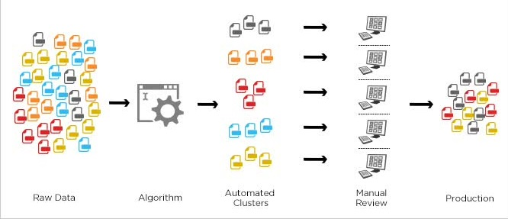
Machine learning
Unsupervised learning
It is used against data that has no historical labels and they have no scoring points for a data set. The goal is to explore the data and find some structure within.
In our project it is used in the initial phase of the problem solution by looking for the error in the "Mellanox Care Booklet" which is a pre-defined file with common errors and their troubleshooting steps.

Slide 9
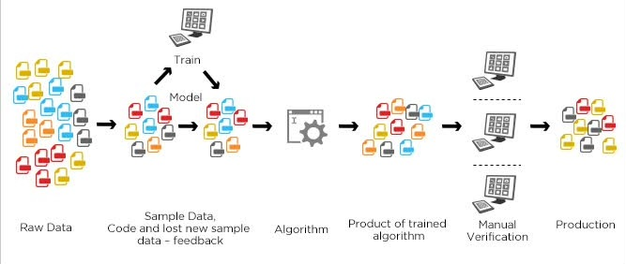
Machine learning
Supervised learning
Uses a predefined input and transition function to achieve desired goal.
The algorithm receives as an input a question by the customer and the reply from the customer to this answered by the engineer. The algorithm then learns how good it was based on determining customer’s nature of reply and modifies the score accordingly.

Slide 10
Machine learning – Ranking
Engineer’s message as possible solution.
“identical” engineer’s messages in different case .
Case closed after one more replay from the customer .
Case closed after three more additional correspondences.
If solution ends with below that 0 points
Add 5 points
Add 1 point
Add 2 points
Negative customer feedback
Add 1 point
Deduct 2 points
rejected
Positive customer feedback
Add 1 point

Slide 11
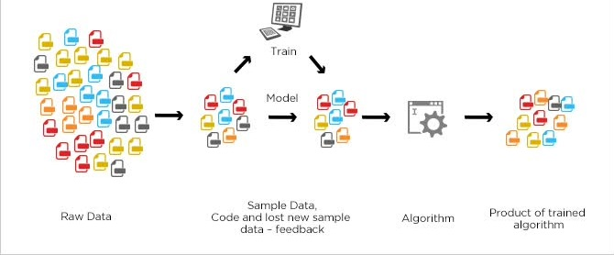
Machine learning
Semi-supervised learning
it uses a small amount of labeled data with a large amount of unlabeled data can be for classification, regression and prediction. the approach will be used in two steps:
1. when solution not found in booklet, used to classify the error type using “Decision Trees” in the “unsupervised learning“ then switch to “supervised learning” phase.
2. If a solution is not found in “unsupervised” phase, will escalate this issue to second tier support engineering team.

Slide 12
Determining a “positive” or “negative” response
“Positive” - solution is helpful - should be considered higher in the order to be reused in further cases with this kind of error.
“negative” - solution is not helpful - should be considered lower in the order to be reused in further cases
Manual classification:
The marking will be done via two checkboxes in the SalesForce CRM: one for positive and one for negative.
A solution can stay in a “natural” state when the classification is not determined.

Slide 13
Natural Language Processing (NLP)
Tokenised text and pattern matching
breaking up a stream of characters into words, punctuation marks, numbers.
negative words like “no” “didn’t help” may reveal that the reply by the engineer wasn’t helpful expressions like “issue resolved” “thanks for the help” may indicate the it was helpful.

Slide 14
Procedure - Algorithm and flow of events
Artificial intelligence “Mellanox care event” handling:
An error is being reported by the Mellanox care system
Salesforce “case” is automatically opened for this error, the case includes: timestamp, device name, source, failure description.
The support engineers attaches the case logs or Daily report logs into the Data-Analyzer.
The Data-Analyzer compares the source and failure description with previous open Mellanox care cases.
If the error does not appear in the opened case or in known issues, then the issue needs to be addressed.

Slide 15
Procedure - Algorithm and flow of events
Artificial intelligence “Mellanox care event” handling:
The Data-Analyzer classifies the error type into 6 types.
If error cannot be found in the booklet it will be classified as a general error.
The Data-Analyzer determines the case priority: P1 for fatal. P2 for medium. P3 for low priority.
The Data-Analyzer describes the error in detail for the support engineer
The Data-Analyzer searches within Salesforce for solutions and ranks them as we stated above.
The Data-Analyzer offers the highest ranking solution within the category.

Slide 16
Procedure - Algorithm and flow of events
Artificial intelligence “Mellanox care event” handling:
A solution can be skipped by the support engineer.
The error type decision branch can be changed.
If solution bank is empty, the appropriate message will be sent and the issue will be escalated to second support tier to handle.
If unclassified solution is regularly being resolved by a certain type solution a message to the engineer will advise to manually classify this error.
Upon receiving the desired suggested solution the support engineer provide it to customer.

Slide 17
Procedure - Algorithm and flow of events
Artificial intelligence “Mellanox care event” handling:
In case the customer feedback is “negative”, the support engineer can run the skip solution until solution bank is empty.
The answer suggestion process is being activated again in a loop, closing in on the root cause of the failure.
The root cause had been found, the issue is resolved.
Case can be closed.

Slide 18
Artificial intelligence “daily report” handling:
Salesforce case is automatically received in a pre-determined time for the daily report.
The support engineers attaches the case logs or Daily report logs into the Data-Analyzer.
The Data-Analyzer compares the new daily report with open Mcare cases
If the error appears in the open case, a message is displayed that the issue has not been resolved the issue needs to be addressed again.
The Data-Analyzer compares the new daily report with yesterday’s daily report

Slide 19
Artificial intelligence “daily report” handling:
If an issue that appears in yesterday’s report is absent from today’s report, message will be shown that the particular error had been cleared and the issue had been resolved.
If so, the support engineers closes the opened case and adds a “positive” feedback that the issue was solved.
The rating of the solution in the latest comment is updated according to steps.
If the error does not appear in the opened case the issue needs to be addressed, a new case needs to be opened.
The process of new case processing begins with step #2 in “Artificial intelligence Error handling

Slide 20
Artificial intelligence “Statistics”:
The support engineers attaches the problem description into the Data-Analyzer.
The Data-Analyzer gathers: timestamp, device name, source, failure description for statistical calculations.
The Data-Analyzer searches in SF and shows how many cases recently opened for this error, this source, and this company.
If unusual grouping of errors is found, the Data-Analyzer calculates the threshold breaches on the groups (threshold adaptation advisory).
On request, the Data-Analyzer provides statistical data on monthly, weekly and daily scale on case opened and alerts on unusual grouping of errors.

Slide 21
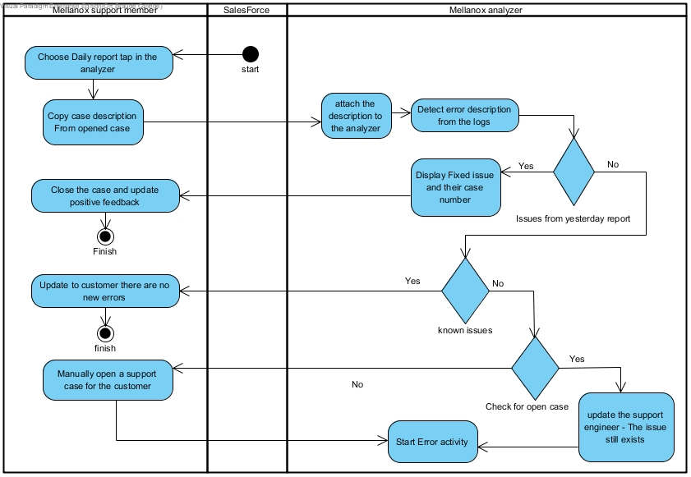
Activity- Mellanox Care Daily report

Slide 22
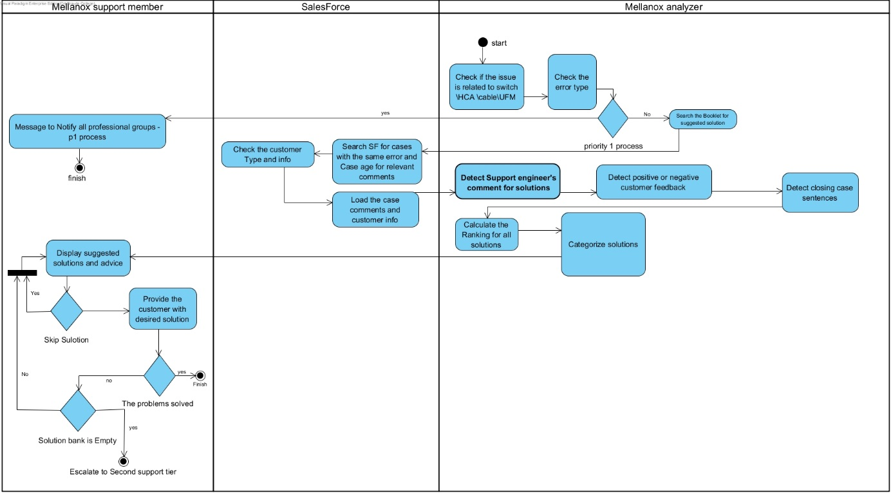
Activity - Handle Error

Slide 23
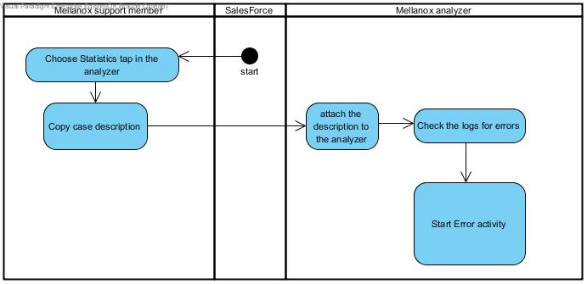
Activity - Mellanox Care Keep alive event:

Slide 24
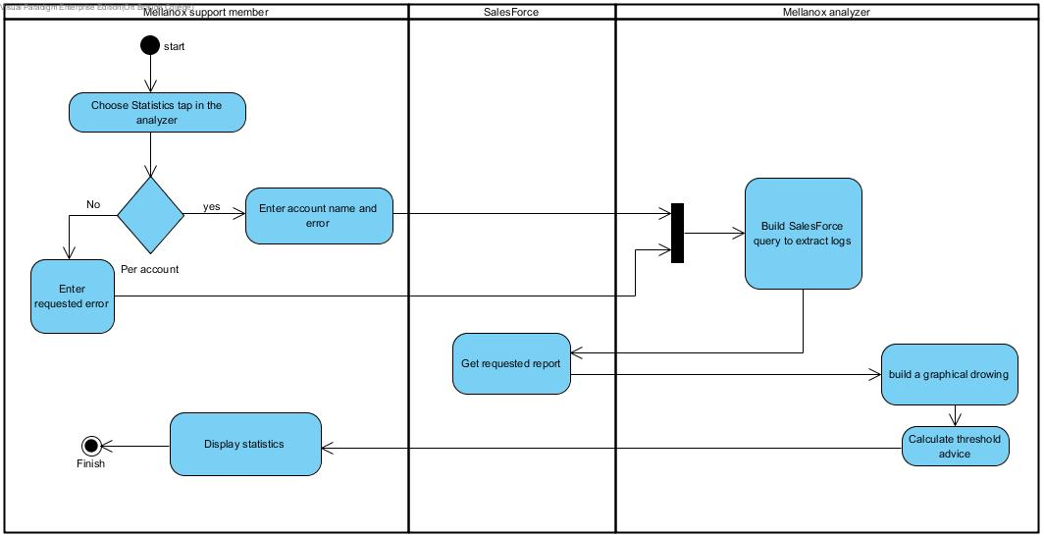
Activity- Show statistics

Slide 25
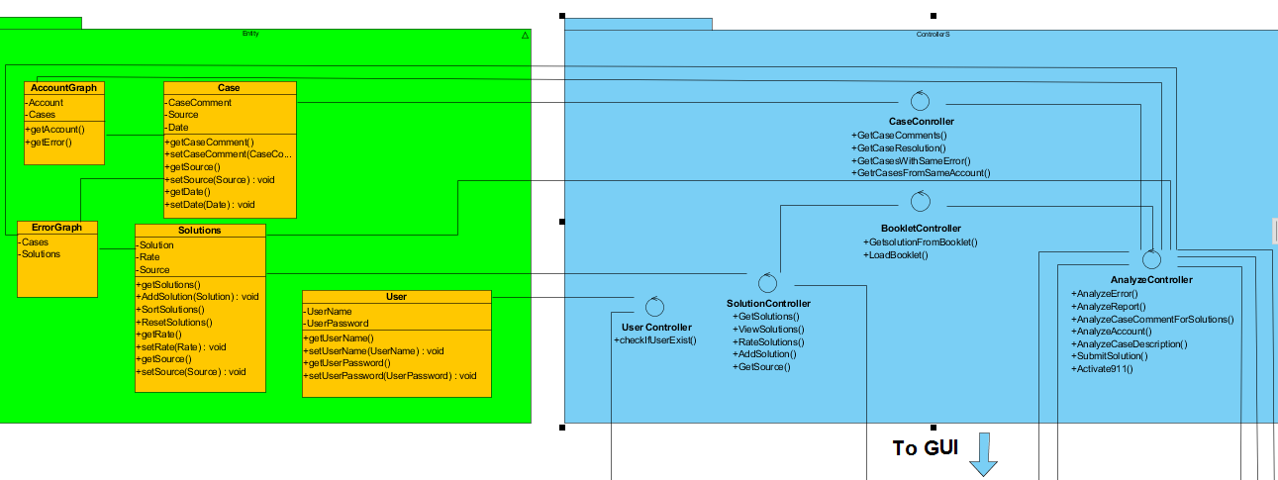
Case Diagram - part 1:

Slide 26
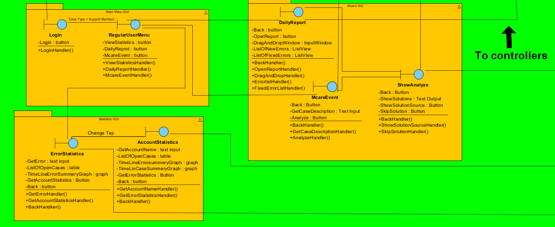
Case Diagram - part 2:

Slide 27
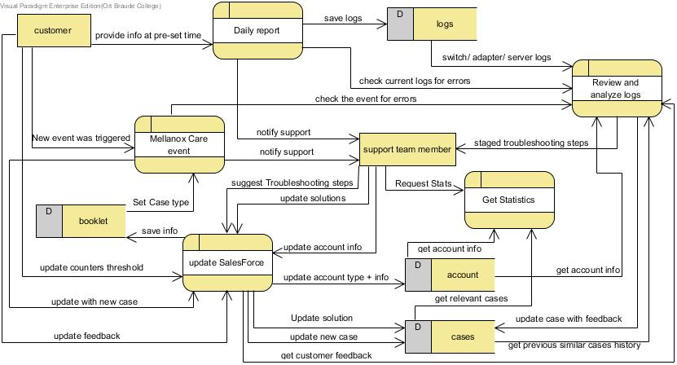
Data Flow Diagram:

Slide 28
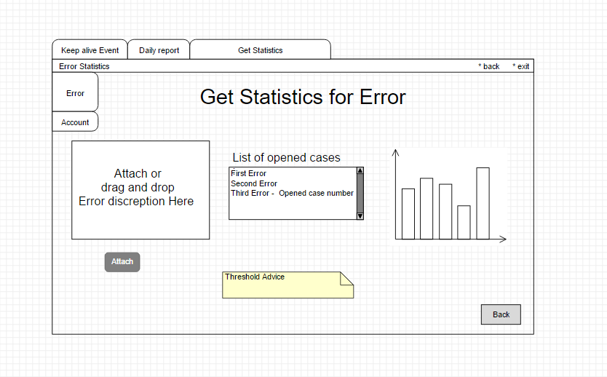
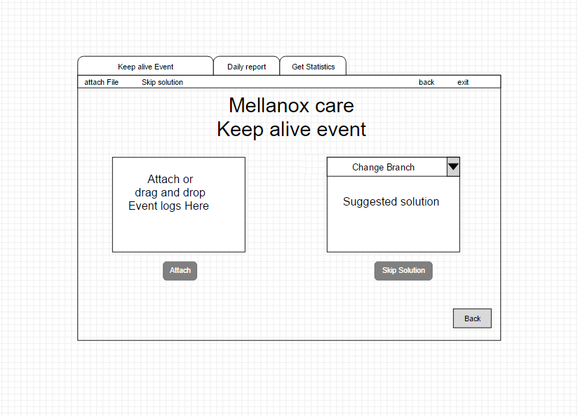
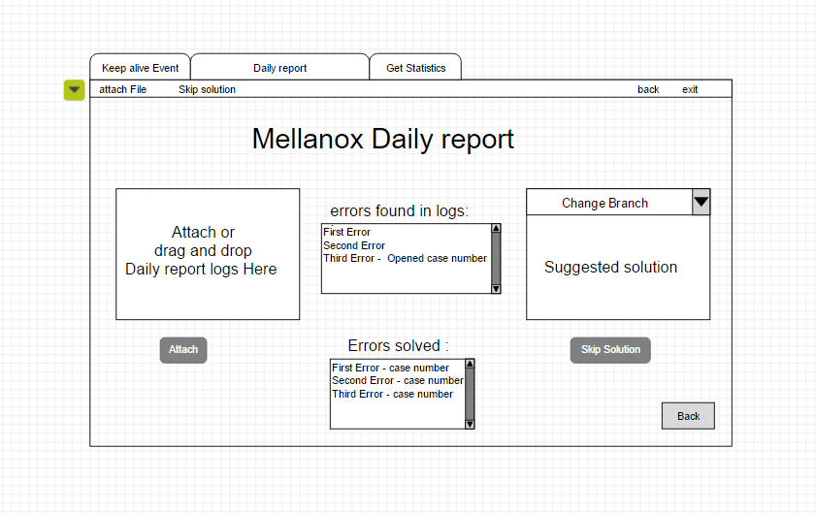
Graphical User Interface (GUI):

Slide 29
Testing plan
Test No. | Test subject | Expected result
1. | Attach Mellanox Daily report with only known issues and issues with opened cases. | To show a message that the report is clear with all numbers of open cases related to the detected issues.
2. | Attach Mellanox Daily report with new error (reported for first time). | To provide the support engineer a message with detailed problem description and a possible solution.
3. | Attach Mellanox care new error log related to hardware issue in order to find a solution. | To provide the support engineer a message with detailed problem description and to suggest to replace the faulty hardware.
4. | 1) Attach Mellanox care new error log related to software issue in order to find a solution and then to skip first solution. 2) Update the customer feedback as positive in Salesforce. 3) Attach Mellanox care event log with the same as previous one. | 1) To provide first and second solution. 2) To provide the second solution as first (has higher score- due to positive feedback).

Slide 30
Testing plan
Test No. | Test subject | Expected result
5. | 1) Attach Mellanox care new error log related to configuration and hardware issue in order to find a solution 2) Negative feedback from customer as a response for first solution. | 1) To provide a configuration guide as a solution. 2) To provide hardware replacement solution
6. | Attach an error log in order to receive statistics. | To show a graph with previously opened cases and threshold advice.
7. | To provide account name in order to receive statistics. | To show a graph with previously opened cases.
8. | To provide account name that doesn’t exist | A message to such an account
9. | Attach Mellanox care new error log for new issue never been handled in order to find a solution. | A message to escalate this issue.
10. | Attach Mellanox care new error log in order to find a solution and skip all suggested solutions. | A message need to escalate this issue.

